Slide 1
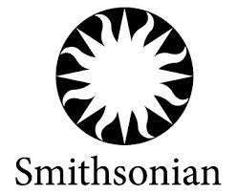
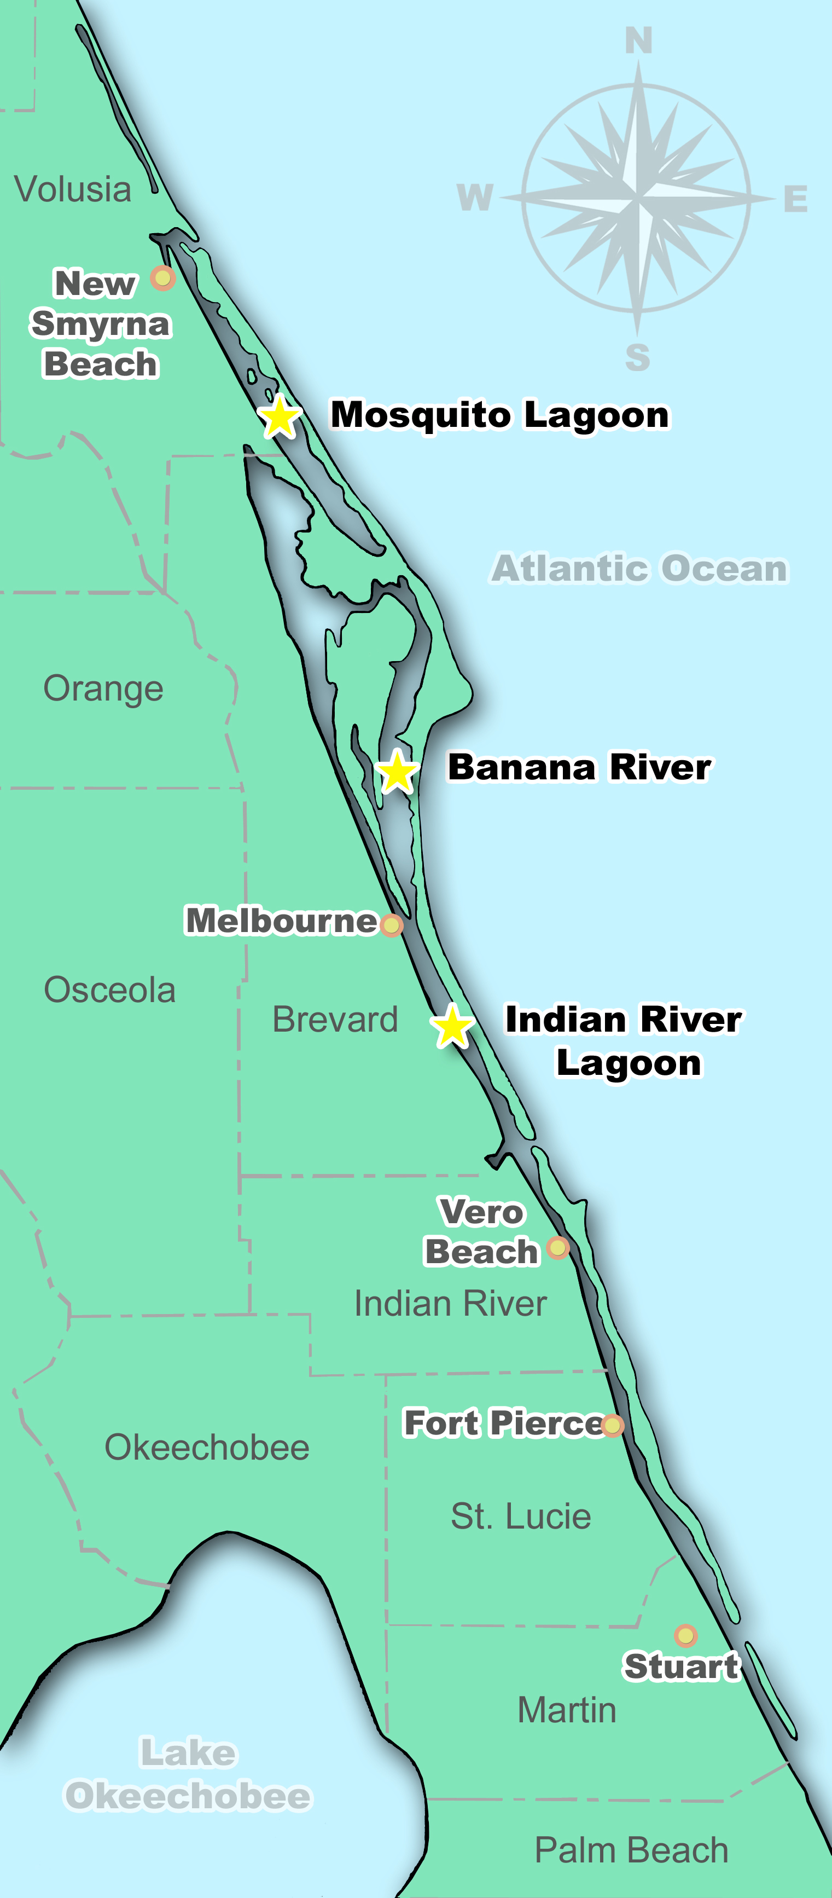
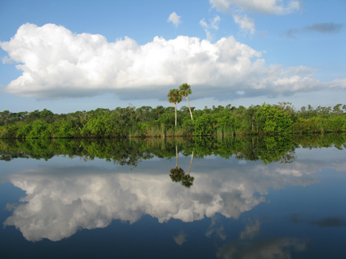
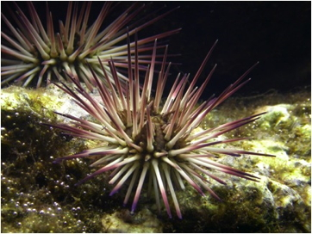
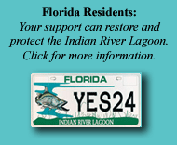
Smithsonian Marine Station at Fort Pierce
IRLSI Home Search the Inventory The IRL Stewardship IRL Photo Gallery Links and Events About Us SMS Home
IRLSI Home >
Copyright ©
Welcome to the Indian River Lagoon
Species Inventory
The Indian River Lagoon (IRL) Species Inventory is an online database that provides comprehensive information on all aspects of IRL biodiversity. It is utilized by a wide variety of audiences including scientists, resource managers, educational groups, and IRL citizenry. The website is continuously updated as new discoveries and information become available. We invite you to increase your knowledge and appreciation of this invaluable natural resource.
Where you can……
Learn
Explore
Participate
Discover the over 3,500
documented species of
animals, plants, protists
and fungi occurring in one
of the most biologically
diverse estuaries in the
continental United States –
the Indian River Lagoon.
To get started, click the
“Search the Inventory” tab.
A vast array of habitats
supports IRL biodiversity by
providing home to thousands
of species. These habitats
are all interconnected, some
are presently threatened.
Start your virtual tour of
these habitats here. It just
might make your next IRL
excursion a lot more
meaningful!
Find out how we, as
individuals, can make
simple changes in our daily
routines to promote
stewardship and
sustainability of the IRL
Get Involved:
Check out our links and
events page
- Participate in the IRL Photo
contest
The Indian River Lagoon (IRL) Species Inventory is an online database that provides comprehensive information on all aspects of IRL biodiversity. It is utilized by a wide variety of audiences including scientists, resource managers, educational groups, and IRL citizenry. The website is continually updated as new discoveries and information become available. We invite you to increase your knowledge and appreciation of this invaluable natural resource.
Species of the Month
Purple-spined Sea Urchin Arbacia punctulata
The Indian River Lagoon (IRL) Species Inventory is an online database that provides comprehensive information on all aspects of IRL biodiversity. It is utilized by a wide variety of audiences including scientists, resource managers, educational groups, and IRL citizenry. The website is continually updated as new discoveries and information become available. We invite you to increase your knowledge and appreciation of this invaluable natural resource.
Contact Us:
Smithsonian Marine Station at Fort Pierce
701 Seaway Drive
Fort Pierce, FL 34949
T: 772-462-6220 FAX: 772-461-8154
Send comments to: irl_webmaster@si.edu
Copyright © 2000 – 2011 Smithsonian Institution

Slide 2
Smithsonian Marine Station at Fort Pierce
IRLSI Home Search the Inventory The IRL Stewardship IRL Photo Gallery Links and Events About Us SMS Home
IRLSI Home >
Copyright ©
Welcome to the Indian River Lagoon
Species Inventory
Where you can……
Learn
Explore
Participate
Discover the over 3,500
documented species of
animals, plants, protists
and fungi occurring in one
of the most biologically
diverse estuaries in the
continental United States –
the Indian River Lagoon.
To get started, click the
“Search the Inventory” tab.
A vast array of habitats
supports IRL biodiversity by
providing home to thousands
of species. These habitats
are all interconnected, some
are presently threatened.
Start your virtual tour of
these habitats here. It just
might make your next IRL
excursion a lot more
meaningful!
Find out how we, as
individuals, can make
simple changes in our daily
routines to promote
stewardship and
sustainability of the IRL
Get Involved:
Check out our links and
events page
- Participate in the IRL Photo
contest
Species of the Month
Purple-spined Sea Urchin Arbacia punctulata
The Indian River Lagoon (IRL) Species Inventory is an online database that provides comprehensive information on all aspects of IRL biodiversity. It is utilized by a wide variety of audiences including scientists, resource managers, educational groups, and IRL citizenry. The website is continually updated as new discoveries and information become available. We invite you to increase your knowledge and appreciation of this invaluable natural resource.
Contact Us:
Smithsonian Marine Station at Fort Pierce
701 Seaway Drive
Fort Pierce, FL 34949
T: 772-462-6220 FAX: 772-461-8154
Send comments to: irl_webmaster@si.edu
Copyright © 2000 – 2011 Smithsonian Institution

Slide 3
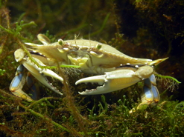
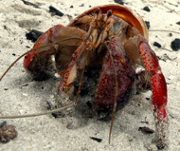
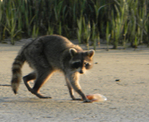
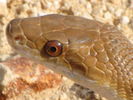
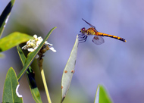
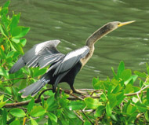
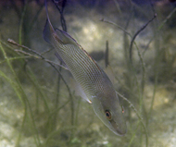
Smithsonian Marine Station at Fort Pierce
IRLSI Home Search the Inventory The IRL Stewardship IRL Photo Gallery Links and Events About Us SMS Home
IRLSI Home > Search the Inventory
Search by
Word or phrase
Go to Species
Reports
Alphabetized
Species Lists
Expanded
Species
Reports
Special Status
Species
Non-Native
Species
Thumbnails
IRL Species
Documentation
Species Names
And Taxonomy
Marine
Invertebrates
The Indian River Lagoon Species Inventory may be searched in a variety of ways to find appropriate information on over 3500 species of animals, plants, fungi and protists occurring in the IRL. Please explore the navigation bars to the left to find out which path works best for you and the information you seek.
The Indian River Lagoon (IRL) Species Inventory may be searched in a variety of ways to find appropriate information on over 3,500 species of animals, plants, fungi and protists occurring in the IRL. Please explore the navigation bars to the left to find out which path works best for you and the information you seek.

Slide 4
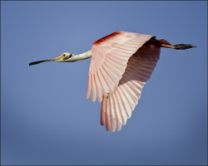
Smithsonian Marine Station at Fort Pierce
IRLSI Home Search the Inventory The IRL Stewardship IRL Photo Gallery Links and Events About Us SMS Home
IRLSI Home > Search the Inventory > Search by Word or Phrase
Search by
Word or Phrase
Go to Species
Reports
Alphabetized
Species Lists
Expanded
Species
Reports
Special Status
Species
Non-Native
Species
Thumbnails
IRL Species
Documentation
Species Names
And Taxonomy
Marine
Invertebrates
Google Search Bar
Type in a word or phrase to search the IRL Species Inventory database.
The Indian River Lagoon (IRL) Species Inventory is an online database that provides comprehensive information on all aspects of IRL biodiversity. It is utilized by a wide variety of audiences including scientists, resource managers, educational groups, and IRL citizenry. The website is continuously updated as new discoveries and information become available. We invite you to increase your knowledge and appreciation of this invaluable natural resource.

Slide 5
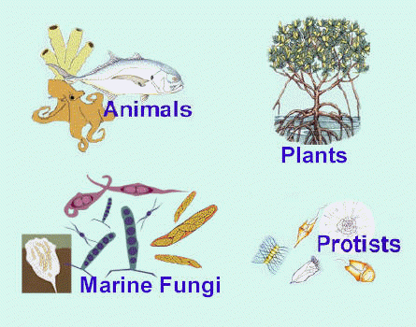
Smithsonian Marine Station at Fort Pierce
IRLSI Home Search the Inventory The IRL Stewardship IRL Photo Gallery Links and Events About Us SMS Home
IRLSI Home > Search the Inventory > Go to Species Reports
Search by
Word or Phrase
Go to Species
Reports
Alphabetized
Species Lists
Expanded
Species
Reports
Special Status
Species
Non-Native
Species
Thumbnails
IRL Species
Documentation
Species Names
And Taxonomy
Marine
Invertebrates
Click your area of interest to
access species information.
The images below represent the four kingdoms - Animalia, Plantae, Fungi and Protista - found in the IRL Species Inventory. Bacteria are not included in the inventory at the present time. Select your area of interest. You will be directed to images of phyla/divisions within respective kingdoms to help narrow your search.
Plants

Slide 6
Smithsonian Marine Station at Fort Pierce
IRLSI Home Search the Inventory The IRL Stewardship IRL Photo Gallery Links and Events About Us SMS Home
IRLSI Home > Search the Inventory > Go to Species Reports
Search by
Word or Phrase
Go to Species
Reports
Alphabetized
Species Lists
Expanded
Species
Reports
Special Status
Species
Non-Native
Species
Thumbnails
IRL Species
Documentation
Species Names
And Taxonomy
Marine
Invertebrates
Click your area of interest to
access species information.

Slide 7
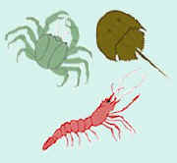
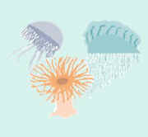
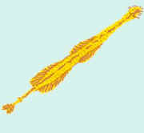
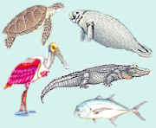
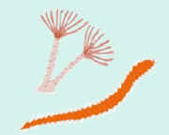
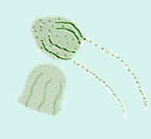
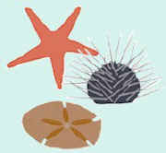
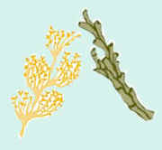
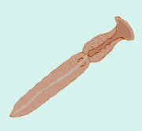
Smithsonian Marine Station at Fort Pierce
IRLSI Home Search the Inventory The IRL Stewardship IRL Photo Gallery Links and Events About Us SMS Home
IRLSI Home > Search the Inventory > Go to Species Reports
Search by
Word or Phrase
Go to Species
Reports
Alphabetized
Species Lists
Expanded
Species
Reports
Special Status
Species
Non-Native
Species
Thumbnails
IRL Species
Documentation
Species Names
And Taxonomy
Marine
Invertebrates

Slide 8
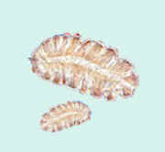
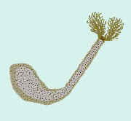
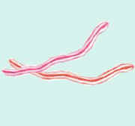
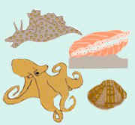
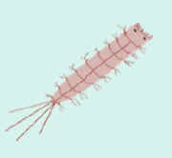
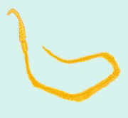
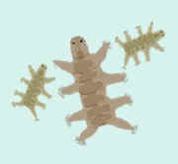
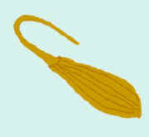
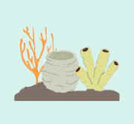
Smithsonian Marine Station at Fort Pierce
IRLSI Home Search the Inventory The IRL Stewardship IRL Photo Gallery Links and Events About Us SMS Home
IRLSI Home > Search the Inventory > Go to Species Reports
Search by
Word or Phrase
Go to Species
Reports
Alphabetized
Species Lists
Expanded
Species
Reports
Special Status
Species
Non-Native
Species
Thumbnails
IRL Species
Documentation
Species Names
And Taxonomy
Marine
Invertebrates
All Other Phyla

Slide 9
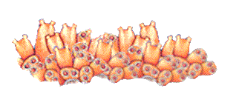
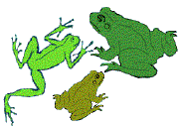
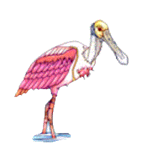
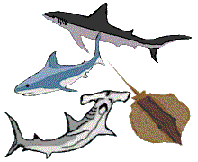
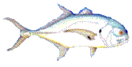
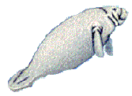
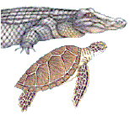
Smithsonian Marine Station at Fort Pierce
IRLSI Home Search the Inventory The IRL Stewardship IRL Photo Gallery Links and Events About Us SMS Home
IRLSI Home > Search the Inventory > Go to Species Reports
Search by
Word or Phrase
Go to Species
Reports
Alphabetized
Species Lists
Expanded
Species
Reports
Special Status
Species
Non-Native
Species
Thumbnails
IRL Species
Documentation
Species Names
And Taxonomy
Marine
Invertebrates

Slide 10
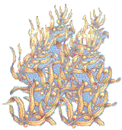
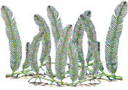
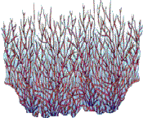
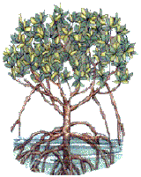
Smithsonian Marine Station at Fort Pierce
IRLSI Home Search the Inventory The IRL Stewardship IRL Photo Gallery Links and Events About Us SMS Home
IRLSI Home > Search the Inventory > Go to Species Reports
Search by
Word or Phrase
Go to Species
Reports
Alphabetized
Species Lists
Expanded
Species
Reports
Special Status
Species
Non-Native
Species
Thumbnails
IRL Species
Documentation
Species Names
And Taxonomy
Marine
Invertebrates

Slide 11
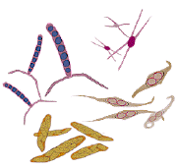
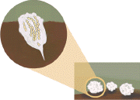
Smithsonian Marine Station at Fort Pierce
IRLSI Home Search the Inventory The IRL Stewardship IRL Photo Gallery Links and Events About Us SMS Home
IRLSI Home > Search the Inventory > Go to Species Reports
Search by
Word or Phrase
Go to Species
Reports
Alphabetized
Species Lists
Expanded
Species
Reports
Special Status
Species
Non-Native
Species
Thumbnails
IRL Species
Documentation
Species Names
And Taxonomy
Marine
Invertebrates

Slide 12
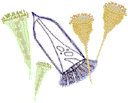
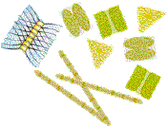
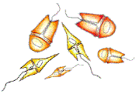
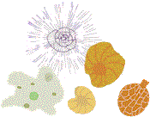
Smithsonian Marine Station at Fort Pierce
IRLSI Home Search the Inventory The IRL Stewardship IRL Photo Gallery Links and Events About Us SMS Home
IRLSI Home > Search the Inventory > Go to Species Reports
Search by
Word or Phrase
Go to Species
Reports
Alphabetized
Species Lists
Expanded
Species
Reports
Special Status
Species
Non-Native
Species
Thumbnails
IRL Species
Documentation
Species Names
And Taxonomy
Marine
Invertebrates

Slide 13
Smithsonian Marine Station at Fort Pierce
IRLSI Home Search the Inventory The IRL Stewardship IRL Photo Gallery Links and Events About Us SMS Home
IRLSI Home > Search the Inventory > Alphabetized Species Lists
Search by
Word or Phrase
Go to Species
Reports
Alphabetized
Species Lists
Expanded
Species
Reports
Special Status
Species
Non-Native
Species
Thumbnails
IRL Species
Documentation
Species Names
And Taxonomy
Marine
Invertebrates
Indian River Lagoon
Alphabetical Species List
A | B | C | D | E | F | G | H | I | J | K | L | M | N | O | P | Q | R | S | T | U | V | W | X | Y | Z
Click a Letter to View an
Alphabetical Listing by Species Name

Slide 14
Smithsonian Marine Station at Fort Pierce
IRLSI Home Search the Inventory The IRL Stewardship IRL Photo Gallery Links and Events About Us SMS Home
IRLSI Home > Search the Inventory > Expanded Species Reports
Search by
Word or Phrase
Go to Species
Reports
Alphabetized
Species Lists
Expanded
Species
Reports
Special Status
Species
Non-Native
Species
Thumbnails
IRL Species
Documentation
Species Names
And Taxonomy
Marine
Invertebrates
Expanded Species Reports
Click on a scientific name to access a report.
Code letters indicate Complete (C) or Partial (P) species accounts.
Many of the organisms in the following table are linked to their
species profiles on the Encyclopedia of Life website. To view these
Profiles, click on the EOL logo to the right of the scientific name. Non-native species are also indicated to the right of the common name.
Code Scientific Name Common Name
C Abudefduf saxatilis Sergeant Major
C Acanthophora spicifera Spiny Seaweed
C Acetabularia calyculus Umbrella Alga
C Achirus lineatus Lined Sole
C Acipenser brevirostrum Shortnose Sturgeon
C Acrostichum aureum Golden Leather Fern
C Actinia bermudensis EOL Maroon Anemone
C Aetea sica Bryozoan
C Aetea truncata Bryozoan
C Agasicles hygrophila Alligatorweed Flea Beetle *Non-Native*
C Aiptasia pallida EOL Brown Anemone

Slide 15
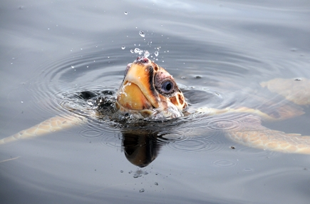
Smithsonian Marine Station at Fort Pierce
IRLSI Home Search the Inventory The IRL Stewardship IRL Photo Gallery Links and Events About Us SMS Home
IRLSI Home > Search the Inventory > Special Status Species
Search by
Word or Phrase
Go to Species
Reports
Alphabetized
Species Lists
Expanded
Species
Reports
Special Status
Species
Non-Native
Species
Thumbnails
IRL Species
Documentation
Species Names
And Taxonomy
Marine
Invertebrates
Special Status Species of the
Indian River Lagoon
KEY TO LISTING STATUS
E - Endangered: According to the Endangered Species Act of 1973, any species which is in danger of extinction throughout all or a significant portion of its range.
T - Threatened: According to the Endangered Species Act of 1973, any species which is likely to become an endangered species within the foreseeable future throughout all or a significant portion of its range.
T1 - Threatened due to similarity of appearance
CE - Commercially Exploited
SSC - Florida State Species of Special Concern Note: These species are listed by the Florida Fish & Wildlife Conservation Commission under one or more of the following criteria:
1: Species has a significant vulnerability to habitat modification, environmental alteration, human disturbance, or human exploitation which, in the foreseeable future, may result in its becoming a threatened species unless appropriate protective or management techniques are initiated or maintained.
2: Species may already meet certain criteria for designation as a threatened species, but for which conclusive data are limited or lacking.
3: Species may occupy such an unusually vital or essential ecological niche that, should it decline significantly in numbers or distribution, other species would be adversely affected to a significant degree.
4: Species has not sufficiently recovered from past population depletion.
5: Species occurs as a population either intentionally introduced or being experimentally managed to attain specific objectives, and the species of special concern prohibitions in Rule 68A-27.002, F.A.C., shall not apply to species so designated, provided that the intentional killing, attempting to kill, posession or sale of such species is prohibited.

Slide 16
Smithsonian Marine Station at Fort Pierce
IRLSI Home Search the Inventory The IRL Stewardship IRL Photo Gallery Links and Events About Us SMS Home
IRLSI Home > Search the Inventory > Special Status Species
Search by
Word or Phrase
Go to Species
Reports
Alphabetized
Species Lists
Expanded
Species
Reports
Special Status
Species
Non-Native
Species
Thumbnails
IRL Species
Documentation
Species Names
And Taxonomy
Marine
Invertebrates

Slide 17


Smithsonian Marine Station at Fort Pierce
IRLSI Home Search the Inventory The IRL Stewardship IRL Photo Gallery Links and Events About Us SMS Home
IRLSI Home > Search the Inventory > Special Status Species
Search by
Word or Phrase
Go to Species
Reports
Alphabetized
Species Lists
Expanded
Species
Reports
Special Status
Species
Non-Native
Species
Thumbnails
IRL Species
Documentation
Species Names
And Taxonomy
Marine
Invertebrates

Slide 18


Smithsonian Marine Station at Fort Pierce
IRLSI Home Search the Inventory The IRL Stewardship IRL Photo Gallery Links and Events About Us SMS Home
IRLSI Home > Search the Inventory > Special Status Species
Search by
Word or Phrase
Go to Species
Reports
Alphabetized
Species Lists
Expanded
Species
Reports
Special Status
Species
Non-Native
Species
Thumbnails
IRL Species
Documentation
Species Names
And Taxonomy
Marine
Invertebrates

Slide 19


Smithsonian Marine Station at Fort Pierce
IRLSI Home Search the Inventory The IRL Stewardship IRL Photo Gallery Links and Events About Us SMS Home
IRLSI Home > Search the Inventory > Special Status Species
Search by
Word or Phrase
Go to Species
Reports
Alphabetized
Species Lists
Expanded
Species
Reports
Special Status
Species
Non-Native
Species
Thumbnails
IRL Species
Documentation
Species Names
And Taxonomy
Marine
Invertebrates

Slide 20


Smithsonian Marine Station at Fort Pierce
IRLSI Home Search the Inventory The IRL Stewardship IRL Photo Gallery Links and Events About Us SMS Home
IRLSI Home > Search the Inventory > Special Status Species
Search by
Word or Phrase
Go to Species
Reports
Alphabetized
Species Lists
Expanded
Species
Reports
Special Status
Species
Non-Native
Species
Thumbnails
IRL Species
Documentation
Species Names
And Taxonomy
Marine
Invertebrates

Slide 21


Smithsonian Marine Station at Fort Pierce
IRLSI Home Search the Inventory The IRL Stewardship IRL Photo Gallery Links and Events About Us SMS Home
IRLSI Home > Search the Inventory > Special Status Species
Search by
Word or Phrase
Go to Species
Reports
Alphabetized
Species Lists
Expanded
Species
Reports
Special Status
Species
Non-Native
Species
Thumbnails
IRL Species
Documentation
Species Names
And Taxonomy
Marine
Invertebrates

Slide 22
Smithsonian Marine Station at Fort Pierce
IRLSI Home Search the Inventory The IRL Stewardship IRL Photo Gallery Links and Events About Us SMS Home
Downloadable Species Database
IRLSI Home > Search the Inventory > Special Status Species
Search by
Word or Phrase
Go to Species
Reports
Alphabetized
Species Lists
Expanded
Species
Reports
Special Status
Species
Non-Native
Species
Thumbnails
IRL Species
Documentation
Species Names
And Taxonomy
Marine
Invertebrates
Downloadable Species Database

Slide 23
Smithsonian Marine Station at Fort Pierce
IRLSI Home Search the Inventory The IRL Stewardship IRL Photo Gallery Links and Events About Us SMS Home
IRLSI Home > Search the Inventory > Special Status Species
Search by
Word or Phrase
Go to Species
Reports
Alphabetized
Species Lists
Expanded
Species
Reports
Special Status
Species
Non-Native
Species
Thumbnails
IRL Species
Documentation
Species Names
And Taxonomy
Marine
Invertebrates

Slide 24
Smithsonian Marine Station at Fort Pierce
IRLSI Home Search the Inventory The IRL Stewardship IRL Photo Gallery Links and Events About Us SMS Home
IRLSI Home > Search the Inventory > Special Status Species
Search by
Word or Phrase
Go to Species
Reports
Alphabetized
Species Lists
Expanded
Species
Reports
Special Status
Species
Non-Native
Species
Thumbnails
IRL Species
Documentation
Species Names
And Taxonomy
Marine
Invertebrates

Slide 25
Smithsonian Marine Station at Fort Pierce
IRLSI Home Search the Inventory The IRL Stewardship IRL Photo Gallery Links and Events About Us SMS Home
Note: Indicate in text that non-native species
are designated in both the expanded species
and alphabetized species lists.
IRLSI Home > Search the Inventory > Non-Native Species
Search by
Word or Phrase
Go to Species
Reports
Alphabetized
Species Lists
Expanded
Species
Reports
Special Status
Species
Non-Native
Species
Thumbnails
IRL Species
Documentation
Species Names
And Taxonomy
Marine
Invertebrates
Non-Native and Invasive Species
of the Indian River Lagoon
Non-native species are species that have been introduced into new areas that have not historically been part of their native range. 'Exotic,' 'alien,' 'nonindigenous,' and 'introduced' are all synonymous terms referring to non-native species. In contrast, native species are species that have historically occurred as part of an ecosystem in a specific location. Native species are also called indigenous species. Introduction is defined by Krueger and May (1991) as the transfer by humans of an organism outside its native range.

Slide 26
Smithsonian Marine Station at Fort Pierce
IRLSI Home Search the Inventory The IRL Stewardship IRL Photo Gallery Links and Events About Us SMS Home
IRLSI Home > Search the Inventory > Thumbnails
Search by
Word or Phrase
Go to Species
Reports
Alphabetized
Species Lists
Expanded
Species
Reports
Special Status
Species
Non-Native
Species
Thumbnails
IRL Species
Documentation
Species Names
And Taxonomy
Marine
Invertebrates
Thumbnails of IRL Species

Slide 27
Smithsonian Marine Station at Fort Pierce
IRLSI Home Search the Inventory The IRL Stewardship IRL Photo Gallery Links and Events About Us SMS Home
IRLSI Home > Search the Inventory > IRL Species Documentation
Search by
Word or Phrase
Go to Species
Reports
Alphabetized
Species Lists
Expanded
Species
Reports
Special Status
Species
Non-Native
Species
Thumbnails
IRL Species
Documentation
Species Names
And Taxonomy
Marine
Invertebrates
Scientific Source Documenting
A Species Occurrence in the IRL

Slide 28
Smithsonian Marine Station at Fort Pierce
IRLSI Home Search the Inventory The IRL Stewardship IRL Photo Gallery Links and Events About Us SMS Home
IRLSI Home > Search the Inventory > Species Names and Taxonomy
Search by
Word or Phrase
Go to Species
Reports
Alphabetized
Species Lists
Expanded
Species
Reports
Special Status
Species
Non-Native
Species
Thumbnails
IRL Species
Documentation
Species Names
And Taxonomy
Marine
Invertebrates
A Word About Species Names …..
Many people wonder why scientists use complicated, hard to pronounce names when speaking about familiar animals and plants. Common names such as blue crab, redfish, and dolphin are successfully used in casual communication, and convey an immediate idea of what a particular animal or plant looks like. Scientists avoid using common names because they are often not specific to a particular species. For instance, the blue crab is only one of many species of crabs that can be described as blue. In the Indian River Lagoon alone, there are several species of "blue crabs": the blue crab (Callinectes sapidus), the lesser blue crab (Callinectes similis), the red blue crab (Callinectes bocourti), the ornate blue crab (Callinectes ornatus), and the blue land crab (Cardisoma guanhumi). Common names can also be confusing in other respects. Another familiar problem occurs when a species has more than one common name. For example, the striped mullet, Mugil cephalus, is found all over the world, and has a variety of common names (striped mullet, black mullet, sea mullet, flathead mullet, and gray mullet) which are used in different regions. Still another problem arises when a species is so obscure that it has no common name. Thus, to avoid any confusion or ambiguity in scientific research, biologists use scientific names in identifying species.What's in a Name?

Slide 29

Smithsonian Marine Station at Fort Pierce
IRLSI Home Search the Inventory The IRL Stewardship IRL Photo Gallery Links and Events About Us SMS Home
IRLSI Home > Search the Inventory > Marine Invertebrates
Search by
Word or Phrase
Go to Species
Reports
Alphabetized
Species Lists
Expanded
Species
Reports
Special Status
Species
Non-Native
Species
Thumbnails
IRL Species
Documentation
Species Names
And Taxonomy
Marine
Invertebrates
It is estimated that 97% of all animal species on earth are invertebrates. The vast majority of animals that live in the ocean also fall into this category. Invertebrates are animals without a backbone (vertebral column). Aside from lacking a backbone, invertebrates share many fundamental traits with other animals. They are multi-cellular, have no cell walls (a characteristic of plants), most have tissues (organized groups of cells), and all are heterotrophic, i.e., they cannot manufacture their own food and depend on other organisms for nutrition. Three groups of marine invertebrates that most of us will have seen but many of us will know little about are the sponges, the cnidarians and the echinoderms. Let’s learn more about these diverse, often colorful and always ecologically important animals..

Slide 30


Smithsonian Marine Station at Fort Pierce
IRLSI Home Search the Inventory The IRL Stewardship IRL Photo Gallery Links and Events About Us SMS Home
IRLSI Home > The IRL
The IRL
What is a
Lagoon?
What is
Biodiversity?
Documented
IRL Biodiversity
IRL Animal
Biodiversity
IRL Plant
Biodiversity
IRL Protist
Biodiversity
IRL Habitats
Threats to IRL
Habitats
Climate Change
and the IRL
The Indian River Lagoon Estuary
The Indian River Lagoon (IRL) estuary is part of the longest barrier island complex in the United States, occupying more than 30% of Florida's east coast. The extent of the IRL system spans approximately 156 miles from Ponce de Leon Inlet in the Mosquito Lagoon to Jupiter Inlet near West Palm Beach.
The IRL is a complex association of terrestrial, wetland and estuarine ecosystems which combine to create a complex ecosystem mosaic with high habitat diversity. But the feature which helps distinguish the IRL system from other estuarine systems, and also accounts for much of the high biological diversity in the Indian River Lagoon, is its unique geographical location, which straddles the transition zone between colder temperate, and warmer sub-tropical biological provinces. Here, as perhaps no where else in the continental United States, tropical and temperate species coexist and thrive.
The Indian River Lagoon System actually consists of 3 lagoons: the Mosquito Lagoon which originates in Volusia County, the Banana River in Brevard County, and the Indian River Lagoon which spans nearly the entire coastal extent of Brevard, Indian River, St. Lucie and Martin Counties.

Slide 31

Smithsonian Marine Station at Fort Pierce
IRLSI Home Search the Inventory The IRL Stewardship IRL Photo Gallery Links and Events About Us SMS Home
IRLSI Home > The IRL > What is a Lagoon?
The IRL
What is a
Lagoon?
What is
Biodiversity?
Documented
IRL Biodiversity
IRL Animal
Biodiversity
IRL Plant
Biodiversity
IRL Protist
Biodiversity
IRL Habitats
Threats to IRL
Habitats
Climate Change
and the IRL
What is a Lagoon?
Lagoons are shallow coastal bodies of water separated from the ocean by a series of barrier islands which lie parallel to the shoreline. Inlets, either natural or man-made, cut through barrier islands and permit tidal currents to transport water into and out of the lagoons. Because lagoons are characteristically shallow, they are strongly influenced by precipitation and evaporation, which results in fluctuating water temperature and salinity. Lagoons can also be fragile ecosystems susceptible to pollution effects from municipal, industrial and agricultural runoff.

Slide 32
Smithsonian Marine Station at Fort Pierce
IRLSI Home Search the Inventory The IRL Stewardship IRL Photo Gallery Links and Events About Us SMS Home
IRLSI Home > The IRL > What is Biodiversity?
The IRL
What is a
Lagoon?
What is
Biodiversity?
Documented
IRL Biodiversity
IRL Animal
Biodiversity
IRL Plant
Biodiversity
IRL Protist
Biodiversity
IRL Habitats
Threats to IRL
Habitats
Climate Change
and the IRL
What is Biodiversity?
The Problem: Loss of Species
By the early 1980s, scientists around the world had begun to recognize that species extinctions were occurring on a global scale. The rate of these extinctions rivaled, or surpassed, those of the Cretaceous period 65 million years ago when many species, including the dinosaurs became extinct. The crisis facing species today differs in one fundamental way from any other extinction events: all other cases of mass extinction throughout global history have come about as the result of climatic change, a natural geological change or some cataclysmic event. The present crisis, however, is being driven by human influences. Throughout the 1980s and early 1990s, the scientific community, the media, the public, and governmental agencies worldwide began working to preserve the biological diversity of terrestrial systems. Issues such as deforestation of tropical forests, overdevelopment, overexploitation of species, pollution, habitat loss, invasions by introduced species, and other issues which addressed habitat preservation and conservation were brought into public focus. However, maintaining the biological diversity of marine and estuarine systems was largely overlooked throughout the 1980s, even though it was generally accepted that marine systems are far more species rich and have greater ecosystem diversity than terrestrial systems. Representatives from 32 of the 33 known animal phyla can be found in ocean and coastal waters. Of these, 15 phyla occur exclusively in estuarine or marine environments.
Defining Biodiversity:
The vast wealth of life on earth is unified by a common strand: DNA. All living things owe their forms and functions to the molecular makeup of their DNA. But perhaps more intriguing than life's unity is its immense diversity. Biological diversity - biodiversity - is one of the central themes of conservation. But w

Slide 33

Smithsonian Marine Station at Fort Pierce
IRLSI Home Search the Inventory The IRL Stewardship IRL Photo Gallery Links and Events About Us SMS Home
IRLSI Home > The IRL > Documented IRL Biodiversity
The IRL
What is a
Lagoon?
What is
Biodiversity?
Documented
IRL Biodiversity
IRL Animal
Biodiversity
IRL Plant
Biodiversity
IRL Protist
Biodiversity
IRL Habitats
Threats to IRL
Habitats
Climate Change
and the IRL
Documented Biodiversity in the
Indian River Lagoon
(based on Swain et al. 1995)*
The original IRL Species Inventory, first compiled in 1995, listed a total of 2493 different species of plants, animals and protists. Of these, animals comprised the greatest proportion of species in the Inventory (71.4%), with 1779 species grouped into 20 phyla. Plants were grouped into 4 phyla, consisting of 289 different species; and the Protista (17.0%) consisted of 425 species in 4 phlya. No data are available for Kingdoms Monera (bacteria) and Fungi (fungus).
* "There is no doubt that some taxa are more complete and thoroughly documented than others........ Taxa for which contributors had a high degree of confidence with complete lists include fishes, birds, mollusks, chrysophytes, dinoflagellates, rhizopods, ectoprocts, sipunculids, echinoderms, and mammals. Other taxonomic groups, including vascular plants, amphibians and reptiles, and marine macroalgae are relatively complete but could benefit from increased sampling over wider areas of the lagoon. Other taxa are, at the very best, partial lists, for example sponges and chaetognaths. " (Swain et al. 1995)

Slide 34

Smithsonian Marine Station at Fort Pierce
IRLSI Home Search the Inventory The IRL Stewardship IRL Photo Gallery Links and Events About Us SMS Home
IRLSI Home > The IRL > IRL Plant Biodiversity
The IRL
What is a
Lagoon?
What is
Biodiversity?
Documented
IRL Biodiversity
IRL Animal
Biodiversity
IRL Plant
Biodiversity
IRL Protist
Biodiversity
IRL Habitats
Threats to IRL
Habitats
Climate Change
and the IRL
IRL Animal Biodiversity
(based on Swain et al. 1995)*
Of those taxa documented, 20 animal phyla, comprising 1779 species, were listed in the original IRL Species Inventory.
Phylum Chordata: Chordate groups (38.7%) consisted of the protochordates and 6 classes of organisms comprising 689 different species. The diversity among fishes and birds accounted for a large amount of the total biodiversity among the chordate group.
Group # Species
Subphylum
Urochordata 31
Class Chondrichthyes 22
Class Osteichthyes 376
Class Amphibia 4
Class Reptilia 20
Class Aves 202
Class Mammalia 34

Slide 35

Smithsonian Marine Station at Fort Pierce
IRLSI Home Search the Inventory The IRL Stewardship IRL Photo Gallery Links and Events About Us SMS Home
IRLSI Home > The IRL > IRL Plant Biodiversity
The IRL
What is a
Lagoon?
What is
Biodiversity?
Documented
IRL Biodiversity
IRL Animal
Biodiversity
IRL Plant
Biodiversity
IRL Protist
Biodiversity
IRL Habitats
Threats to IRL
Habitats
Climate Change
and the IRL
IRL Plant Biodiversity
(based on Swain et al. 1995)*
Plants comprised 11.6% of the total species biodiversity documented in the original IRL Species Inventory. The Tracheophyta (vascular plants), accounted for over half (50.9%) of all plants inventoried. The Rhodophyta (red algae) accounted for 25.6% of species diversity, while the Chlorophyta (green algae), and the Phaeophyta (brown algae) accounted for 15.6% and 7.9% respectively.
Group # Species
Division Tracheophyta 147
Division Rhodophyta 74
Division Chlorophyta 45
Division Phaeophyta 23

Slide 36

Smithsonian Marine Station at Fort Pierce
IRLSI Home Search the Inventory The IRL Stewardship IRL Photo Gallery Links and Events About Us SMS Home
IRLSI Home > The IRL > IRL Protist Biodiversity
The IRL
What is a
Lagoon?
What is
Biodiversity?
Documented
IRL Biodiversity
IRL Animal
Biodiversity
IRL Plant
Biodiversity
IRL Protist
Biodiversity
IRL Habitats
Threats to IRL
Habitats
Climate Change
and the IRL
IRL Protist Biodiversity
(based on Swain et al. 1995)*
Of the protists documented in the original Inventory, over half (53.4%) were Chrysophyta (diatoms). The Rhizopoda (amoebas and forams) comprised 21.9% of the species diversity among Protists, while the Ciliophora (ciliates) and the Dinoflagellata (dinoflagellates) comprised 19.3% and 5.4% respectively.
Group # Species
Phylum Chrysophyta 227
Phylum Rhizopoda 93
Phylum Ciliophora 82
Phylum Dinoflagellata23

Slide 37

Smithsonian Marine Station at Fort Pierce
IRLSI Home Search the Inventory The IRL Stewardship IRL Photo Gallery Links and Events About Us SMS Home
IRLSI Home > The IRL > IRL Habitats
The IRL
What is a
Lagoon?
What is
Biodiversity?
Documented
IRL Biodiversity
IRL Animal
Biodiversity
IRL Plant
Biodiversity
IRL Protist
Biodiversity
IRL Habitats
Threats to IRL
Habitats
Climate Change
and the IRL
The Indian River Lagoon:
a Mosaic of Habitats
Note: need to create way of getting back to
this page from the individual habitat pages
Topographic profile of representative Indian River Lagoon habitats: (1) mangrove/salt marsh; (2) submerged habitats within the Indian River Lagoon; (3) mangrove fringe; (4) oak forest/maritime hammock; (5) oak scrub; (6) saw palmetto scrub; (7) sea oats foredune; (8) beach.
Barrier Island/Intertidal Habitats Submerged Habitats
Beaches Oyster Reefs
Dunes Seagrass Beds
Scrub
Maritime Hammock
Mangrove Fringe
Mosquito Impoundments
Salt Marshes
Tidal Flats
Q: What is an ecosystem?
Ecosystems are defined as communities of plants, animals and microorganisms found within a particular area, interacting with each other and with the environment. Hence, the term "ecosystem" encompasses both the biotic and abiotic (living and non-living) components of a particular environment. Ecosystems are complex and dynamic entities that use energy, produce wastes and recycle nutrients. All ecosystems, whether marine or terrestrial, are interconnected. What occurs in one ecosystem affects the dynamics of another. Collectively, all ecosystems make up the biosphere, or zone of life, which occurs in the thin outer layer of the Earth's surface.

Slide 38





Smithsonian Marine Station at Fort Pierce
IRLSI Home Search the Inventory The IRL Stewardship IRL Photo Gallery Links and Events About Us SMS Home
IRLSI Home > The IRL > IRL Habitats > Barrier Island Habitats
The IRL
What is a
Lagoon?
What is
Biodiversity?
Documented
IRL Biodiversity
IRL Animal
Biodiversity
IRL Plant
Biodiversity
IRL Protist
Biodiversity
IRL Habitats
Threats to IRL
Habitats
Climate Change
and the IRL
Barrier Island Habitats
Beach Dune Scrub
Hammock Mangrove
The extensive barrier island system along the east coast of Florida is the largest in the United States, consisting of approximately 189,300 hectares (467,700 acres) (Kaplan 1988). In east central Florida, barrier islands separate the Atlantic Ocean from the Indian River Lagoon (IRL) and are an important defense against hurricanes and major storms, buffering mainland Florida against large waves, heavy winds, and storm surges. Barrier islands are dynamic features of the landscape that form in two ways: 1) from longshore drift currents move sands southward along the coast; and 2) from the emergence of underwater shoals (Otvos 1981). It is believed that Florida’s barrier islands originated during the Pleistocene epoch (1.75 million to 11,000 years ago) when rises in ancient beach and their associated sediments lithified into coquina (rock). Traces of this coquina system, called the Anastasia Formation, can be found from St. Augustine to Boca Raton, Florida (Tanner 1960b).

Slide 39

Smithsonian Marine Station at Fort Pierce
IRLSI Home Search the Inventory The IRL Stewardship IRL Photo Gallery Links and Events About Us SMS Home
IRLSI Home > The IRL > IRL Habitats > Beach Habitats
The IRL
What is a
Lagoon?
What is
Biodiversity?
Documented
IRL Biodiversity
IRL Animal
Biodiversity
IRL Plant
Biodiversity
IRL Protist
Biodiversity
IRL Habitats
Threats to IRL
Habitats
Climate Change
and the IRL
Beach Habitats
The Florida peninsula is bordered by 1900 km (1181 miles) of tidal coastline, second only to Alaska. Of this total, approximately 1200 km (746 miles), primarily along Florida’s east coast, consists of sandy beaches where high energy waves constantly break along the shoreline. In northern areas along the east coast of Florida, including the northern Indian River Lagoon area, sands are composed principally of quartz that originated in the Appalachian Mountains, and calcium carbonate from rock and shell deposits. Further south, the amount of quartz in sand decreases steadily, and sand composition becomes primarily calcium carbonate.
Beaches lie at the interface between the land and the ocean. East coast beaches in Florida, especially those in the Indian River Lagoon area, are generally dynamic, high-energy, areas. The unique topography and slope of any beach area is the result of interactions between both abiotic and biotic factors. Key physical processes in beach and dune formation are wave action, erosion, sand accretion by winds, overwash, and the deposition of salt spray (Stalter 1976; Tyndall 1985). Important biotic factors generally center around the ability of plants to colonize and grow while withstanding the adverse effects of being buried in sand and inundated by sea water. Additionally, colonizing species of plants must also be able to tolerate the xeric conditions which result from sand being generally well drained with low nutrient availability.

Slide 40

Smithsonian Marine Station at Fort Pierce
IRLSI Home Search the Inventory The IRL Stewardship IRL Photo Gallery Links and Events About Us SMS Home
IRLSI Home > The IRL > IRL Habitats > Dune Habitats
The IRL
What is a
Lagoon?
What is
Biodiversity?
Documented
IRL Biodiversity
IRL Animal
Biodiversity
IRL Plant
Biodiversity
IRL Protist
Biodiversity
IRL Habitats
Threats to IRL
Habitats
Climate Change
and the IRL
Dune Habitats
Dune Formation:
On virtually any barrier island, wind and sand combine to create sand dunes. Dunes play a vital role in protecting coastlines and property. They act as buffers against severe storms, protecting the lands beyond the dune from salt water intrusion, high wind and storm surges. Dunes also act as sand reservoirs, which are important for replenishing coastlines after tropical storms, hurricanes, intense wave action, or other erosional events.
The process of dune formation begins with the transport of sand landward via saltation, surface creep, or suspension. Saltation occurs when medium sized grains of sand are transported up the slope of a beach as the result of winds blowing them along the beach surface. Surface creep is the movement of larger sized grains that are rolled along the beach surface due to collisions with bouncing mid-sized sand grains as they are blown up the beach during the saltation process. Perhaps the most common transport process is suspension, in which small sand grains are picked up by winds and blown landward in onshore breezes. This sand is deposited on the upper beach when the flow of wind is impeded by some obstruction (plants, driftwood, flotsam, etc.) that causes the wind to lose speed and momentum. Suspended sand grains then fall out of the air and are deposited on the slip face, or….

Slide 41

Smithsonian Marine Station at Fort Pierce
IRLSI Home Search the Inventory The IRL Stewardship IRL Photo Gallery Links and Events About Us SMS Home
IRLSI Home > The IRL > IRL Habitats > Scrub Habitats
The IRL
What is a
Lagoon?
What is
Biodiversity?
Documented
IRL Biodiversity
IRL Animal
Biodiversity
IRL Plant
Biodiversity
IRL Protist
Biodiversity
IRL Habitats
Threats to IRL
Habitats
Climate Change
and the IRL
Scrub Habitats
Stable backdune areas give rise to scrub communities built upon sandy or well drained soils, with the predominant vegetation being herbaceous shrubs, evergreen oaks, or pines. Coastal scrub communities, commonly referred to as coastal strand, are becoming vanishing ecosystems due to developmental pressures in the coastal zone. Most of the coastal habitats from Cape Canaveral in Brevard County, to Miami in Dade County have been highly fragmented due to development. In Brevard County alone, it has been estimated that the natural scrub community was diminished by 69% during the period between 1943 – 1991 (Schmalzer 1995; Robinson and Smith 1996).

Slide 42


Smithsonian Marine Station at Fort Pierce
IRLSI Home Search the Inventory The IRL Stewardship IRL Photo Gallery Links and Events About Us SMS Home
IRLSI Home > The IRL > IRL Habitats > Decline of Scrub Habitats
The IRL
What is a
Lagoon?
What is
Biodiversity?
Documented
IRL Biodiversity
IRL Animal
Biodiversity
IRL Plant
Biodiversity
IRL Protist
Biodiversity
IRL Habitats
Threats to IRL
Habitats
Climate Change
and the IRL
Decline of Scrub Habitats
U.S. Census Bureau statistics for population growth in Florida from 1860 through 2020. Note that the total for the year 2020 is a projected figure.

Slide 43

Smithsonian Marine Station at Fort Pierce
IRLSI Home Search the Inventory The IRL Stewardship IRL Photo Gallery Links and Events About Us SMS Home
IRLSI Home > The IRL > IRL Habitats > Maritime Hammock Habitats
The IRL
What is a
Lagoon?
What is
Biodiversity?
Documented
IRL Biodiversity
IRL Animal
Biodiversity
IRL Plant
Biodiversity
IRL Protist
Biodiversity
IRL Habitats
Threats to IRL
Habitats
Climate Change
and the IRL
Maritime Hammock Habitats
Maritime hammocks, also known as maritime forests, tropical hammocks or coastal hammocks, are characterized as narrow bands of forest that develop almost exclusively on stabilized backdunes of barrier islands, inland of primary dunes and scrub. Maritime forests occur discontinuously along the entire Atlantic coast of the United States, interrupted by natural features such as inlets and bays, and anthropogenic activities such as coastal development and agriculture. Adjacent maritime forests tend to be vegetatively similar to one another, but overall vegetation profiles change with latitude. Florida, which has the longest coastline in the contiguous United States, has approximately 468,000 acres (Bellis 1995) of barrier islands, with maritime forests occupying the highest, most stable areas of these islands. The present location and extent of today’s maritime forests were established approximately 5000 years ago, becoming stabilized as sea level rise declined from 0.3 m to 0.1 m per century (Bellis 1995).

Slide 44



Smithsonian Marine Station at Fort Pierce
IRLSI Home Search the Inventory The IRL Stewardship IRL Photo Gallery Links and Events About Us SMS Home
IRLSI Home > The IRL > IRL Habitats > Mangrove Habitats
The IRL
What is a
Lagoon?
What is
Biodiversity?
Documented
IRL Biodiversity
IRL Animal
Biodiversity
IRL Plant
Biodiversity
IRL Protist
Biodiversity
IRL Habitats
Threats to IRL
Habitats
Climate Change
and the IRL
Mangrove Habitats
MANGROVES OF FLORIDA
The term mangrove is loosely used to describe a wide variety of often unrelated tropical and subtropical trees and shrubs which share common characteristics. Globally, more than 50 species in 16 different families are considered mangroves

Slide 45

Smithsonian Marine Station at Fort Pierce
IRLSI Home Search the Inventory The IRL Stewardship IRL Photo Gallery Links and Events About Us SMS Home
IRLSI Home > The IRL > Mosquito Impoundments
The IRL
What is a
Lagoon?
What is
Biodiversity?
Documented
IRL Biodiversity
IRL Animal
Biodiversity
IRL Plant
Biodiversity
IRL Protist
Biodiversity
IRL Habitats
Threats to IRL
Habitats
Climate Change
and the IRL
Mosquito Impoundments
Mosquito control impoundments are areas of salt marsh or mangrove forest that have been diked to allow control of water levels for purposes of mosquito control. Within the dikes, perimeter ditches are flooded artificially in order to control breeding and reproduction of salt marsh mosquitoes without the use of pesticides. Florida’s mangroves and salt marshes have historically been problem areas in one important respect: they are preferred breeding habitat for salt marsh mosquitoes (Ochlerotatus taeniorrhynchus and O. sollicitans). These mosquitoes are an important nuisance species that affect the health of humans and domestic animals. Salt marsh mosquitoes do not reproduce by laying their eggs in standing water. Rather, they deposit eggs in the moist soils of high marsh above the water line in tidal wetlands (Provost 1976). Eggs will remain dormant, often for long periods of time, until water levels rise in response to rains or tides. Eggs hatch in the water and undergo several larval stages be

Slide 46




Smithsonian Marine Station at Fort Pierce
IRLSI Home Search the Inventory The IRL Stewardship IRL Photo Gallery Links and Events About Us SMS Home
IRLSI Home > The IRL > IRL Habitats > Salt Marsh Habitats
The IRL
What is a
Lagoon?
What is
Biodiversity?
Documented
IRL Biodiversity
IRL Animal
Biodiversity
IRL Plant
Biodiversity
IRL Protist
Biodiversity
IRL Habitats
Threats to IRL
Habitats
Climate Change
and the IRL
Salt Marsh Habitats
SALT MARSHES DEFINED
Salt marshes form in sheltered coastal areas where sediments accumulate and allow growth of angiosperm plants (Pennings & Bertness 2001) that comprise the foundation of the ecosystem. Salt marshes develop between terrestrial and marine environments, resulting in biologically diverse communities adapted for harsh environmental conditions including desiccation, flooding, and extreme temperature and salinity fluctuations. Marshes act as nurseries to a wide variety of organisms, some of which are notably threat

Slide 47

Smithsonian Marine Station at Fort Pierce
IRLSI Home Search the Inventory The IRL Stewardship IRL Photo Gallery Links and Events About Us SMS Home
IRLSI Home > The IRL > IRL Habitats > Tidal Flat Habitats
The IRL
What is a
Lagoon?
What is
Biodiversity?
Documented
IRL Biodiversity
IRL Animal
Biodiversity
IRL Plant
Biodiversity
IRL Protist
Biodiversity
IRL Habitats
Threats to IRL
Habitats
Climate Change
and the IRL
Tidal Flat Habitats
Fig. 1. Indian River Lagoon tidal flat: (A) view of flat on eastern edge of Coon Island, Ft. Pierce, FL.; (B) exposed area of flat with Ft. Pierce Inlet in background; (C) protected area of flat with Tucker Cove in background.
WHAT ARE TIDAL FLATS?
Tidal flats are intertidal, non-vegetated, soft sediment habitats, found between mean high-water and mean low-water spring tide datums (Dyer et al. 2000) and are generally located in estuaries and other low ene

Slide 48


Smithsonian Marine Station at Fort Pierce
IRLSI Home Search the Inventory The IRL Stewardship IRL Photo Gallery Links and Events About Us SMS Home
IRLSI Home > The IRL > IRL Habitats > Oyster Reef Habitats
The IRL
What is a
Lagoon?
What is
Biodiversity?
Documented
IRL Biodiversity
IRL Animal
Biodiversity
IRL Plant
Biodiversity
IRL Protist
Biodiversity
IRL Habitats
Threats to IRL
Habitats
Climate Change
and the IRL
Oyster Reef Habitats
Oyster reefs, often referred to as oyster bars, are common submerged habitats in the southern United States. Oyster reefs in Florida are found in nearshore areas and estuaries of both coasts, but grow especially vigorously near estuarine river mouths where waters are brackish and less than 10 meters deep. For example, the Apalachicola River in northern Florida…….
Oyster reefs are built primarily by the eastern oyster, Crassostrea virginica, through successive reproduction and settlement of larvae onto existing reef structure. Oysters in Florida spawn from late spring through the fall. The planktonic larvae that develop require a hard substratum to settle upon in order to complete development to the juvenile stage, and prefer to settle on the shells of other oysters. Thus, over time, continued settlement and subsequent growth of generations of oysters may form massive reef structures consisting of staggering numbers of individuals. Luntz (1960), estimated

Slide 49

Smithsonian Marine Station at Fort Pierce
IRLSI Home Search the Inventory The IRL Stewardship IRL Photo Gallery Links and Events About Us SMS Home
IRLSI Home > The IRL > IRL Habitats > Seagrass Habitats
The IRL
What is a
Lagoon?
What is
Biodiversity?
Documented
IRL Biodiversity
IRL Animal
Biodiversity
IRL Plant
Biodiversity
IRL Protist
Biodiversity
IRL Habitats
Threats to IRL
Habitats
Climate Change
and the IRL
Seagrass Habitats
What is seagrass?
Seagrasses are a type of submerged aquatic vegetation (SAV) have evolved from terrestrial plants and have become specialized to live in the marine environment. Like terrestrial plants, seagrasses have leaves, roots, conducting tissues, flowers and seeds, and manufacture their own food via photosynthesis. Unlike terrestrial plants, however, seagrasses do not possess the strong, supportive stems and trunks required to overcome the force of gravity on land. Rather, seagrass blades are supported by the natural buoyancy of water, remaining flexible when exposed to waves and currents.

Slide 50


Smithsonian Marine Station at Fort Pierce
IRLSI Home Search the Inventory The IRL Stewardship IRL Photo Gallery Links and Events About Us SMS Home
IRLSI Home > The IRL > Threats to IRL Habitats
The IRL
What is a
Lagoon?
What is
Biodiversity?
Documented
IRL Biodiversity
IRL Animal
Biodiversity
IRL Plant
Biodiversity
IRL Protist
Biodiversity
IRL Habitats
Threats to IRL
Habitats
Climate Change
and the IRL
HABITAT THREATS SALT MARSHES & MANGROVES
Mosquito Impoundments
Impounding of salt marshes and mangrove forests is likely the most broadly reaching and destructive disturbance in these coastal Florida ecosystems (Montague & Wiegert 1990). Before mosquito control methods like impoundments were in place, mosquito landings were among the highest densities ever recorded in the continental United States (Provost 1949), reaching 500 per person per minute in some areas of Florida (Leenhouts 1983). Ditching in marshes in the 1930s was ineffective, and the use of DDT pesticide in the 1940s had adverse effects on wildlife (Montague & Wiegert 1990). In the 1950s, impounding marshes became an effective and seemingly less invasi
Note: Need to copy remainder of article!

Slide 51
Smithsonian Marine Station at Fort Pierce
IRLSI Home Search the Inventory The IRL Stewardship IRL Photo Gallery Links and Events About Us SMS Home
NOTE: PAGE UNDER CONSTRUCTION!
IRLSI Home > The IRL > Climate Change and the IRL
The IRL
What is a
Lagoon?
What is
Biodiversity?
Documented
IRL Biodiversity
IRL Animal
Biodiversity
IRL Plant
Biodiversity
IRL Protist
Biodiversity
IRL Habitats
Threats to IRL
Habitats
Climate Change
and the IRL
Climate Change Relative to the IRL

Slide 52

Smithsonian Marine Station at Fort Pierce
Stewardship
IRLSI Home Search the Inventory The IRL Stewardship IRL Photo Gallery Links and Events About Us SMS Home
Note: Need to copy remainder of article and all
Associated photographs
IRLSI Home > Stewardship
Stewardship
The Indian River Lagoon (IRL) (Fig. 1 & 8) is one of the most biodiverse estuaries in the United States and directly impacts all of us who live within its watershed on a daily basis. Critical to IRL’s remarkable biodiversity is its water quality. Why is water quality so important? Maintaining high standards of water quality, among other things, supports healthy seagrass beds. Seagrasses serve a vital role in the ecology of the IRL. Not onl

Slide 53

Smithsonian Marine Station at Fort Pierce
IRLSI Home Search the Inventory The IRL Stewardship IRL Photo Gallery Links and Events About Us SMS Home
IRLSI Home > IRL Photo Gallery
IRL Photo
Gallery
Welcome to the 2012 Indian River Lagoon Photo Gallery. We are pleased to highlight the creativity of the many local photographers who contributed their work to the annual Indian River Lagoon Photo Contest, sponsored by the St. Johns River and South Florida Water Management Districts and Environmental Consulting and Technology, Inc. Thanks to everyone who Choose a category below to enter the gallery and view this year's entries:
Winning Photos & Runners-Up
Lagoon Wildlife
Work & Play on the IRL
Landmarks & Landscapes
Sunrise & Sunset
Gallery Archives! Select a year below to view previous photo contest submissions:2011
2010
2009
Need to complete this page with as many
past galleries as possible. Also nee to add info
about participating in the contest

Slide 54

Smithsonian Marine Station at Fort Pierce
IRLSI Home Search the Inventory The IRL Stewardship IRL Photo Gallery Links and Events About Us SMS Home
IRLSI Home > Links and Events
Links and
Events
Indian River Lagoon Conservation
And Education Links
Indian River Lagoon
National Estuary Program
EPA National Estury Program:
Profile: Indian River Lagoon
The St. Johns River Water
Management District
The South Florida Water
Management District
Indian River Lagoon Events
Note: This page needs to be completed and
links updated.
Also will need to obtain event info from IRL NEP

Slide 55
Smithsonian Marine Station at Fort Pierce
IRLSI Home Search the Inventory The IRL Stewardship IRL Photo Gallery Links and Events About Us SMS Home
IRLSI Home > About Us
ADD PHOTO
About Us
An Overview of the Indian River Lagoon Species Inventory Project
The geographical position of the Indian River Lagoon (IRL), straddling the zone of overlap between the temperate and subtropical biotic provinces, contributes to its vast species richness. The IRL had often been purported to be one of the most divers………………. NOTE: This section needs to be updated
Mission Statement
The Smithsonian Marine Station at Fort Pierce became the depository for the Indian River Lagoon Species inventory in 1997. Our goal in obtaining the Inventory is to continue to promote public awareness and the need for stewardship of the IRL as an invaluable marine resource. In order to accomplish this objective, we have expanded the initial database by adding additional taxonomic, ecological and life history information. ………..
NOTE: This section needs to be updated
Acknowledgements
The Smithsonian Marine Station at Fort Pierce sincerely acknowledges the following organizations and individuals who contributed generously to the Indian River Lagoon Species Inventory Project……
NOTE: This section needs to be updated
Contact Information
Smithsonian Marine Station at Fort Pierce
701 Seaway Drive
Fort Pierce, FL 34949
T: 772-462-6220 FAX: 772-461-8154
Send comments to: irl_webmaster@si.edu

Slide 56
Smithsonian Marine Station at Fort Pierce
IRLSI Home Search the Inventory The IRL Stewardship IRL Photo Gallery Links and Events About Us SMS Home
IRLSI Home > SMS Home
SMS Home
Note: The SMS Home Nav bar above will go directly
to the SMS Home Page

Slide 57
Smithsonian Marine Station at Fort Pierce
IRLSI Home Search the Inventory The IRL Stewardship IRL Photo Gallery Links and Events About Us SMS Home
NOTES to self:
Habitat pages have associated species lists that
link up to narratives.
Pop-Up Definition Boxes?
Linked reference in Scrub Habitat description
Habitat descriptions are linked several ways:
by image, or highlighted link either on
IRL Habitat page or Barrier Island/Intertidal
Habitat Page.

